Slide 1
Welcome to our class!

Slide 2
Warm-up

Slide 3
Let’s play!

Slide 4
1/10
Choose the odd one out.
- summer
- autumn - winter
- jeans
- spring
jeans
Answer

Slide 5
2/10
Choose the odd one out.
- hot
- a blouse
- trousers
- jeans
- a jumper
hot
Answer

Slide 6
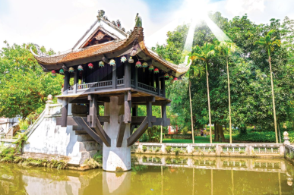
3/10
A: How’s the weather in Ha Noi in summer?
B: ___________
It’s hot.
Answer

Slide 7
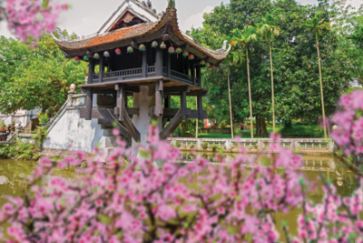
4/10
A: How’s the weather in Ha Noi in spring?
B: _____________
It’s warm.
Answer

Slide 8
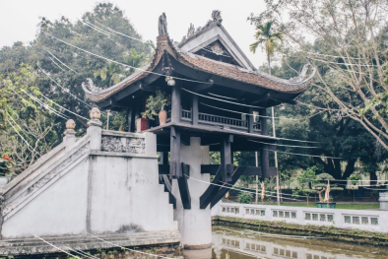
5/10
A: ___________
B: It’s cold.
How’s the weather in Ha Noi in winter?
Answer

Slide 9
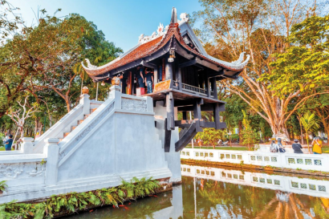
6/10
A: ___________
B: ___________
- How’s the weather in Ha Noi in autumn? - It’s cool.
Answer

Slide 10
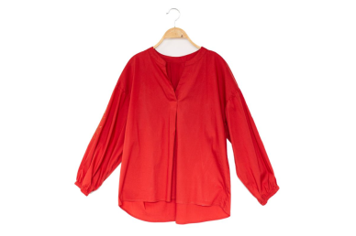
7/10
A: What do you usually wear in Spring?
B: ____________
I wear a blouse.
Answer

Slide 11
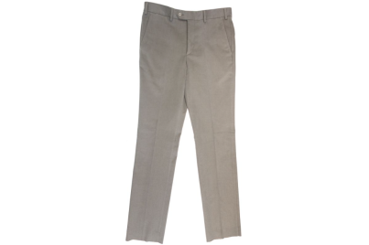
8/10
A: What do you usually wear in summer?
B: ____________
I wear trousers.
Answer

Slide 12
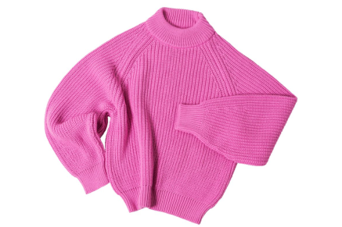
9/10
A: ___________
B: ___________
- What do you usually wear in winter? - I wear a jumper.
Answer

Slide 13
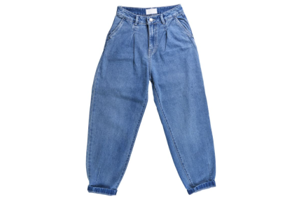
10/10
A: ___________
B: ___________
- What do you usually wear in autumn?
- I wear jeans.
Answer

Slide 14
Great!

Slide 15
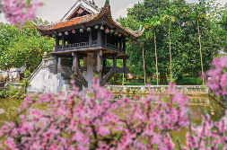
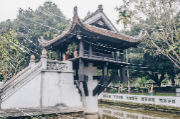
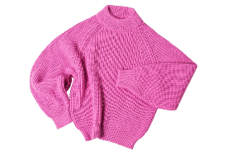
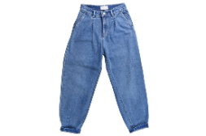
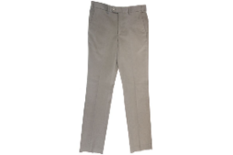
Wednesday, April 2nd 2025
Unit 16
Seasons and the weather
Lesson 3 (4+5+6)

Slide 16
Contents
Read and complete.
Let’s write.
Project

Slide 17
4. Read and complete.
There are different climates in Viet Nam. In the north, there are four seasons: spring, summer, autumn and winter. Spring is warm and humid. It has blooming flowers and festivals. Summer is sunny and hot. It is ideal for holidays. Autumn is cool and cloudy. Many festivals are in autumn. Winter is cold and dry. It is ideal for indoor sports.
In the south, there are two seasons: the dry season and the rainy season. In the dry season, the weather is dry and cool, but in the rainy season, it is rainy and humid.
1
2
3
4
5
Viet Nam | seasons | weather
In the north | spring summer autumn winter | warm and humid (1) _______________ (2) _______________ (3) _______________
In the south | (4) ______________ (5) ______________ | dry and cool rainy and humid
sunny and hot
cool and cloudy
cold and dry
the dry season
the rainy season

Slide 18
5. Let’s write.
Write about your local weather and typical outfits for each season.
(about 40 words)
- How many seasons are there in your area?
- How’s the weather in each season?
- What do you usually wear in each season?
There are _____ seasons ____________. It’s _______________
________________________________________________________________________________________________________________________________________________________________________________________________________________
four
in Hung Yen
warm and sunny
during the spring.
I wear a skirt and a blouse.
Summer is hot and
sunny.
I wear shorts and a T-shirt.
Autumn is cool and windy.
I wear trousers and a T-shirt.
Winter is cold and dry.
I wear jeans
and a jumper.

Slide 19
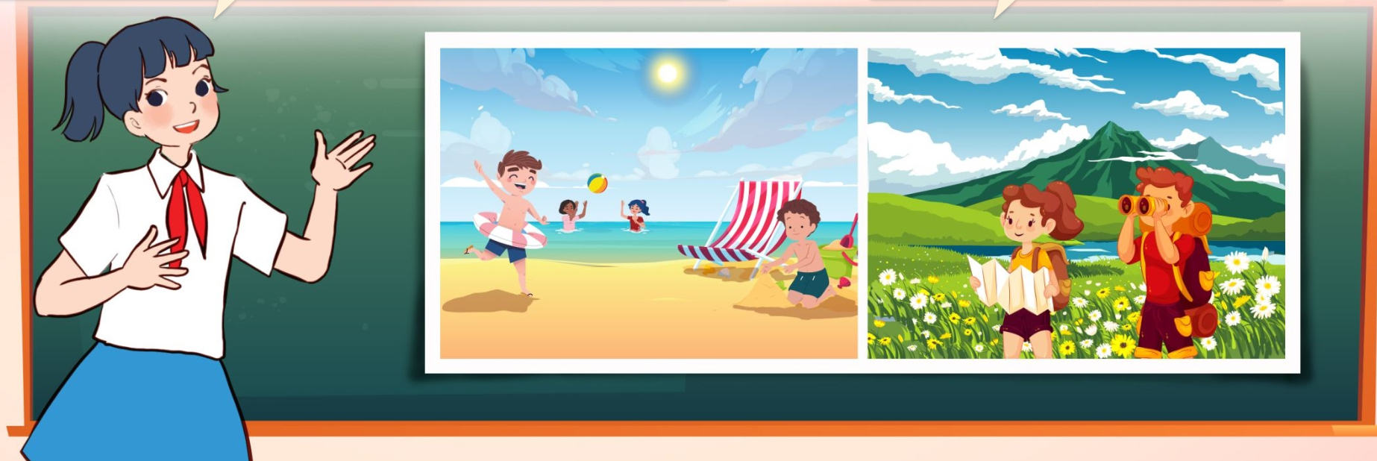
6. Project.
Posters about the seasons
My favourite season is ________. It’s ______.
I usually wear ______.

Slide 20
Fun corner
& wrap - up

Slide 21
1/8
Listen and choose.
A B C

Slide 22
2/8
Listen and choose.
A B C

Slide 23
3/8
Listen and choose.
A B C

Slide 24
4/8
Listen and choose.
A B C

Slide 25
5/8
Listen and choose.
A B C

Slide 26
6/8
Listen and choose.
A B C

Slide 27
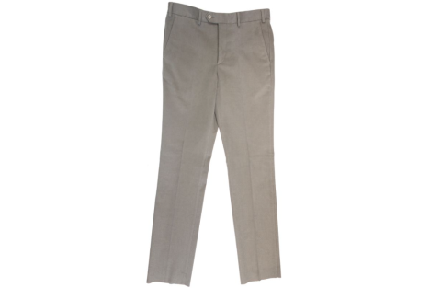
Listen and choose.
7/8
A B C

Slide 28
8/8
Listen and choose.
A B C

Slide 29
Good job!

Slide 30
Review
How’s the weather in Ha Noi in _____?
It’s ________.
spring / warm
winter / cold
summer / hot
autumn / cool

Slide 31
Review
What do you usually wear in _____?
I wear _______.
spring / a blouse
winter / a jumper
summer / trousers
autumn / jeans

Slide 32
Homework
……………………………………. Prepare for unit 17 lesson 1 (1+2+3).

Slide 33
Goodbye!

