Slide 2
Warm-up

Slide 3
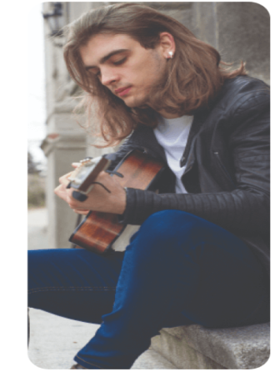
Facebook: Bùi Liễu
0968142780
Let’s chant.
Who’s that?
Who’s that?
It’s my brother.
It’s my sister.
What does he look like?
What does she look like?
He has long hair.
She has a round face.
His hair is long.
Her face is round.

Slide 4
Monday, May 20th 2025
Unit
14
DAILY ACTIVITIES
Lesson 1 (1+2+3)

Slide 5
Contents
Look, listen and repeat.
Listen, point and say.
Let’s talk.

Slide 6
1. Look, listen and repeat.
What’s your hobby, Mai?
When do you watch TV?
a
b
I like watching TV.
I watch TV in the evening.
What are they talking about?
Where are they?
Who are they?
Click on the speaker / sentences to listen.

Slide 7
Vocabulary

Slide 8
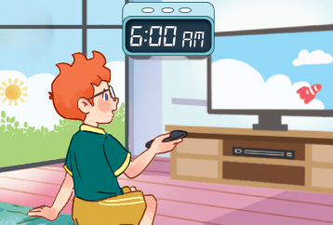
Vocabulary
in the morning
/ɪn ðəˈmɔ:nɪŋ/
vào buổi sáng
Click on the English words to listen.

Slide 9
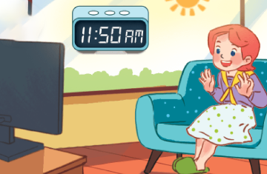
at noon
/æt nu:n/
vào buổi trưa

Slide 10
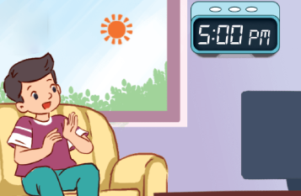
in the afternoon
/ɪn ðiːˌɑːftəˈnuːn/
vào buổi chiều

Slide 11
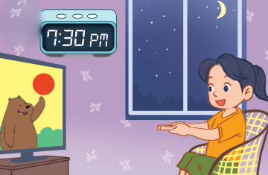
in the evening
/ɪn ðiːˈi:vnɪŋ/
vào buổi tối

Slide 12
Review
in the morning
at noon
in the afternoon
in the evening

Slide 13
Vocabulary
1. in the morning
: vào buổi sáng
2. at noon
: vào buổi trưa
3. in the afternoon
: vào buổi chiều
4. in the evening
: vào buổi tối
Click on the English words to listen.

Slide 14
Checking vocabulary!

Slide 15
in the afternoon

Slide 16
Can you guess?
at noon

Slide 17
Can you guess?
in the evening

Slide 18
Can you guess?
in the morning

Slide 19
Well done!

Slide 20
Structures

Slide 21
Cách hỏi bạn xem tivi vào lúc nào:
When do you watch TV?
( Bạn xem tivi vào lúc nào?)
I watch TV _______.
(Tôi xem tivi _________.)
Ex:
When do you watch TV?
I watch TV in the morning.

Slide 22
Unit 14
lesson 1 (1+2+3)
When do you watch TV?
I watch TV ________.
in the morning
in the evening
at noon
in the afternoon

Slide 23
2. Listen, point and say.
a
b
When do you watch TV?
in the morning
at noon
I watch TV _________.
c
d
in the afternoon
in the evening

Slide 24
2. Listen, point and say.
a
When do you watch TV?
I watch TV _______.
in the morning
When do you watch TV?
I watch TV in the morning.
Click on the sentences to listen.

Slide 25
2. Listen, point and say.
b
When do you watch TV?
I watch TV _______.
at noon
When do you watch TV?
I watch TV at noon.

Slide 26
2. Listen, point and say.
c
When do you watch TV?
I watch TV _______.
in the afternoon
When do you watch TV?
I watch TV in the afternoon.

Slide 27
2. Listen, point and say.
d
When do you watch TV?
I watch TV _______.
in the evening
When do you watch TV?
I watch TV in the evening.

Slide 28
3. Let’s talk.
When do you watch TV?
___________.

Slide 29
3. Let’s talk.
When do you watch TV?
__________________.
I watch TV in the morning

Slide 30
3. Let’s talk.
When do you watch TV?
_____________.
I watch TV at noon

Slide 31
3. Let’s talk.
When do you watch TV?
____________________.
I watch TV in the afternoon

Slide 32
3. Let’s talk.
When do you watch TV?
____________________.
I watch TV in the evening

Slide 33
Let’s play!

Slide 34
- Nhấn vào “spin” để quay, nhấn vào mũi tên đỏ để dừng. Sau đó chọn câu hỏi.
Lucky wheel
30
20
1
2
3
40
10
50
80
4
5
6
60
70
7
8
9
Spin

Slide 35
A. in the afternoon
B. in the evening
C. in the morning
D. at noon
Back

Slide 36
A. in the evening
B. at noon
C. in the afternoon
D. in the morning
Back

Slide 37
A: When do you watch TV?
B: _______________.
A: When do you watch TV?
B: _______________.
A. I watch TV in the morning.
B. I watch TV at noon.
C. I watch TV in the afternoon.
D. I watch TV in the evening.
Back

Slide 38
A: When do you watch TV?
B: _______________.
A. I watch TV at noon.
B. I watch TV in the morning.
C. I watch TV in the evening.
D. I watch TV in the afternoon.
Back

Slide 39
Listen and choose.
A.
B.
C.
D.
Back

Slide 40
Listen and choose.
A.
B.
C.
D.
Back

Slide 41
A: When do you watch TV?
B: I watch TV at noon.
A. False
B. True
Back

Slide 42
Look, listen and choose.
→ I watch TV in
the evening.
A. False
B. True
Back

Slide 43
A: ___________________
B: I watch TV in the afternoon.
A. What time is it?
B. What time do you get up?
C. When do you watch TV?
D. Where’s your school?
Back

Slide 44
Thank you!

Slide 45
Wrap up

Slide 46
Unit 14
lesson 1 (1+2+3)
When do you watch TV?
I watch TV ________.
in the morning
in the evening
at noon
in the afternoon

Slide 47
Homework
Learn by heart all the new words and the model sentences.
Read again the dialogue in part 1.

Slide 48
Facebook : Bùi Liễu
0968142780
Thank you!

